Slide 1
New Drug Update 2018
Rachael McCaleb, PharmD, BCPS
Assistant Professor, Department of Pharmacy Practice
University of Arkansas for Medical Sciences College of Pharmacy

Slide 2
Disclosures
I have nothing to disclose concerning possible financial or personal relationships with commercial entities that may have a direct or indirect interest in the subject matter of this presentation.

Slide 3
Objectives
Recognize drugs that gained FDA approval within the last year
Describe indications, doses, formulations, adverse effects, and drug interactions of recently approved drugs
Summarize clinical data for recently approved drugs
Identify information regarding the recently approved drugs that should be communicated to patients

Slide 4
HIV
Cystic Fibrosis
ID
Neurology
Immune Modulators
Cancer

Slide 5
HIV

Slide 6
Bictegravir, emtricitabine, and tenofovir alafenamide (Biktarvy®)
Indication: Treatment of HIV-1 infection in adults:
As initial therapy in those with no antiretroviral treatment history; OR
Replace a stable antiretroviral regimen in those who are virologically suppressed (HIV-1 RNA <50 copies/mL) for ≥3 months
Approval Date: February 7, 2018
MOA:
Biktarvy (bictegravir, emtricitabine, tenofovir alafenamide) [prescribing information]. Foster City, CA; Gilead Sciences: February 2018.
Notes:
TAF is similar to tenofovir disoproxil fumarate (TDF), the active ingredient in Viread and a component of Stribild, Atripla, Complera and Truvada. TAF, however, can be used at much lower doses and is expected to cause fewer kidney- and bone-related side effects.

Slide 7
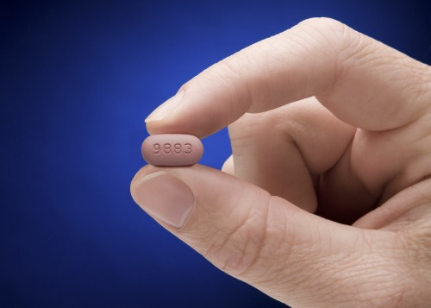
Bictegravir, emtricitabine, and tenofovir alafenamide (Biktarvy®)
Dosage: One tablet (bictegravir 50 mg, emtricitabine 200 mg, and tenofovir alafenamide 25 mg) once daily
Boxed Warning: Post treatment acute exacerbation of Hep B
Adverse Reactions: Headache, diarrhea, and nausea
Biktarvy (bictegravir, emtricitabine, tenofovir alafenamide) [prescribing information]. Foster City, CA; Gilead Sciences: February 2018.

Slide 8
Bictegravir, emtricitabine, and tenofovir alafenamide (Biktarvy®)
NI to other regimens
Treatment naïve
Biktarvy (bictegravir, emtricitabine, tenofovir alafenamide) [prescribing information]. Foster City, CA; Gilead Sciences: February 2018.
Notes:
Triumeq (dolutegravir/abacavir/lamivudine)
Tivicay (dolutegravir) plus Descovy (emtricitabine/tenofovir alafenamide)
The studies were primarily geared to determine whether Biktarvy suppressed HIV at rates comparable to other ARV regimens after 48 weeks of treatment; on this count, the regimen succeeded in all four trials. Thus Biktarvy was determined noninferior, or as effective as, to the other regimens.
In Study 1490, 645 first-timers to treatment were evenly randomized to receive Biktarvy or Tivicay (dolutegravir) plus Descovy (emtricitabine/tenofovir alafenamide). (In other words, the regimens were identical except for the integrase inhibitor component: The participants took either bictegravir or Tivicay.)

Slide 9
Bictegravir, emtricitabine, and tenofovir alafenamide (Biktarvy®)
NI to other regimens
Switched to Biktarvy
Biktarvy (bictegravir, emtricitabine, tenofovir alafenamide) [prescribing information]. Foster City, CA; Gilead Sciences: February 2018.
Notes:
Study 1878 including a boosted protease inhibitor—Reyataz (atazanavir) or Prezista (darunavir)—plus two NRTIs—Epzicom (abacavir/lamivudine) or Truvada (tenofovir disoproxil fumarate/emtricitabine).

Slide 10
Prices of all once daily regimens for HIV regimens
Medication |  | AWP | Cost per Year
Juluca | Dolutegravir / rilpivirine | $3,094.80 (30) | $36,724.96
Complera | Rilpivirine / emtricitabine / tenofovir DF | $3,216.92 (30) | $39,139.17
Odefsey | Rilpivirine / emtricitabine / tenofovir AF | $3,216.92 (30) | $39,139.17
Atripla | Efavirenz / emtricitabine / tenofovir DF | $3,268.88 (30) | $39,771.35
Triumeq | Dolutegravir / abacavir / lamivudine | $3,366.24 (30) | $40,955.92
Genvoya | Elvitegravir / cobicistat / emtricitabine / tenofovir AF | $3,534.78 (30) | $43,006.49
Biktarvy | Bictegravir / emtricitabine / tenofovir AF | $3,534.78 (30) | $43,006.49
Stribild | Elvitegravir / cobicistat / emtricitabine / tenofovir DF | $3,707.99 (30) | $45,113.85
Biktarvy (bictegravir, emtricitabine, tenofovir alafenamide) [prescribing information]. Foster City, CA; Gilead Sciences: February 2018.
Notes:
Note from 10/17/17 HIV Guidelines: “Tenofovir alafenamide (TAF( and tenofovir disoproxil fumarate (TDF) are two forms of tenofovir approved by the FDA. TAF has fewer bone and kidney toxicities than TDF, while TDF is associated with lower lipid levels. Safety, cost, and access are among the factors to consider when choosing between these drugs.”

Slide 11
Ibalizumab-uiyk (Trogarzo®)
Indication: Treatment of HIV-1 in combination w/ other antiretrovirals in heavily treatment-experienced adults with multidrug resistant HIV-1 infection failing their current regimen
Approval Date: March 3, 2018
MOA:
Recombinant monoclonal antibody, post-attachment inhibitor
Blocks HIV-1 from infecting CD4+ T cells by binding to CD4+ cell receptors and interfering with post-attachment
Trogarzo (ibalizumab-uiyk) [prescribing information]. Irvine, CA: TaiMed Biologics USA Corp; May 2018.
Notes:
Blocks viral entry w/o causing immunosuppression

Slide 12
Ibalizumab-uiyk (Trogarzo®)
Dosage: 2000 mg IV as a single dose, then 800 mg IV dose every 14 days
Maintenance dose missed by ≥3 days must restart with 2000 mg loading dose
Given with an optimized background regimen
Precautions:
Immune reconstitution inflammatory syndrome (IRIS)
Combination with other antiretrovirals
Adverse Reactions: Diarrhea, dizziness, nausea, and rash
Trogarzo (ibalizumab-uiyk) [prescribing information]. Irvine, CA: TaiMed Biologics USA Corp; May 2018.
Notes:
An OBR consists of the best antiretroviral therapy that can be made for each patient based on the patterns of HIV drug resistance in their virus.

Slide 13
Ibalizumab-uiyk (Trogarzo®)
Clinical Evidence
TMB-301: Single-arm, multicenter trial with 40 heavily treatment-experienced HIV-infected patients with multidrug resistant HIV
Requirements: Viral load >1000 copies/mL, resistance to at least 1 antiretroviral drug from each of the class (NRTI, NNRTI, PI) for at least 6 months of prior treatment
Day 0-6 (control period): Monitor patients
Day 7-13 (Functional monotherapy): Received loading dose and continued on failing therapy (if applicable)
Day 14 to Week 25: Received maintenance dose and optimized background therapy to include at least 1 susceptible drug
Trogarzo (ibalizumab-uiyk) [prescribing information]. Irvine, CA: TaiMed Biologics USA Corp; May 2018.
Notes:
18% having viral loads above 100,000 copies/mL
At baseline, the median viral load was about 35,000 copies per mL and the median CD4+ T cell counts was 73 cells/mm3

Slide 14
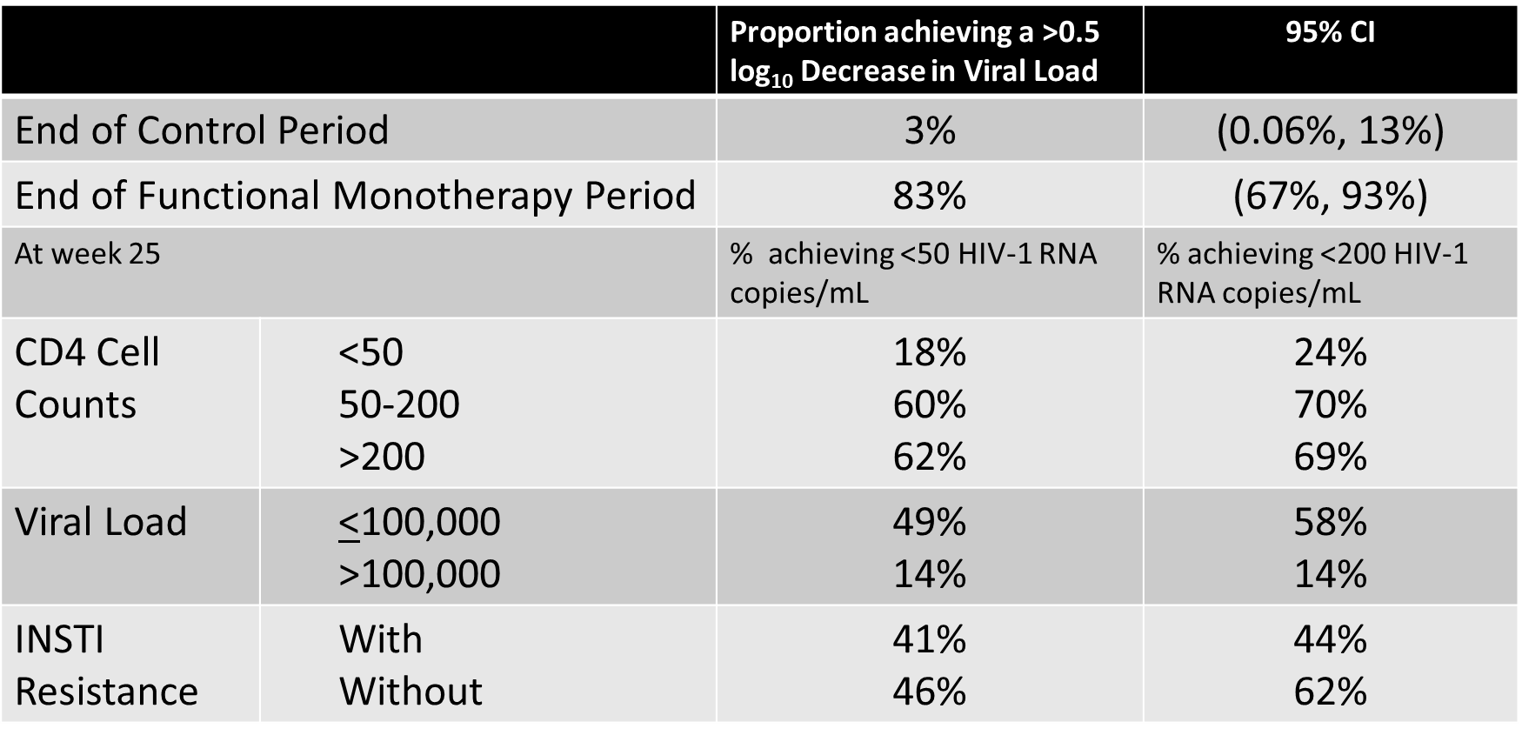
Ibalizumab-uiyk (Trogarzo®)
Baseline median viral load and CD4+ T cell counts were 35,350 copies/ mL and 73 cells/mm³, respectively.
Trogarzo (ibalizumab-uiyk) [prescribing information]. Irvine, CA: TaiMed Biologics USA Corp; May 2018.
Notes:
The FDA approved the first antiretroviral, zidovudine—more commonly called AZT—in 1987
The researchers also did a subgroup analysis and found that of those who had an initial viral load of 100,000 or less (33 subjects), half achieved a ≥0.5 log10 decrease in viral load. Of the seven subjects who started the study with a viral load of more than 100,000, only one achieved a ≥0.5 log10 decrease in viral load. Basically, it appears to work better in those with a lower viral load.
On the other hand, that assessment was done after just one dose. At the end of the therapy through Week 24, only 13 subjects had CD4+ T cell counts over 200 cells per mL. And the limited data from the trial that led to Trogarzo’s approval suggest that the drug may have limited efficacy in people whose HIV viral titer exceeds 100,000 copies per mL. To state the obvious, Trogarzo was approved with minimal data. It means many questions remain unanswered.

Slide 15
Cystic Fibrosis

Slide 16
Tezacaftor and ivacaftor (Symdeko®)
Indication: Treatment of CF patients ≥12 years and homozygous for the F508del mutation or with >1 CFTR gene mutation
Approval Date: February 12, 2018
MOA:
https://www.symdekohcp.com/assets/files/clinical-results.pdf
Symdeko (tezacaftor and ivacaftor) [prescribing information]. Boston, MA: Vertex Pharmaceuticals Incorporated; February 2018.

Slide 17
Tezacaftor and ivacaftor (Symdeko®)
Dosage: Tezacaftor 100 mg/ivacaftor 150 mg in the morning and ivacaftor 150 mg in the evening, ~12 hours apart
Safety Information:
Transaminase elevations (monitor every 3 months during 1st year of treatment then annually)
Co-administration with strong CYP3A inducers not recommended (reduction in effect)
Cataracts (cases in pediatric patients)
Adverse Reactions: Headache, nausea, sinus congestion
Symdeko (tezacaftor and ivacaftor) [prescribing information]. Boston, MA: Vertex Pharmaceuticals Incorporated; February 2018.

Slide 18
Tezacaftor and ivacaftor (Symdeko®)
all mutations listed with * have associated CLINICAL data, all others are derived from in-vitro data.
Symdeko (tezacaftor and ivacaftor) [prescribing information]. Boston, MA: Vertex Pharmaceuticals Incorporated; February 2018.

Slide 19
Tezacaftor and ivacaftor (Symdeko®)
EVOLVE study evaluated the combination in people who have two copies of the F508del mutation
EXPAND study evaluated the combination in people with one F508del mutation and one mutation that results in residual CFTR function
Tezacaftor/ivacaftor combination, ivacaftor monotherapy or placebo
Taylor-Cousar JL, et al. N Engl J Med 2017; 377:2013-2023; Rowe SM, et al. N Engl J Med 2017; 377:2024-2035.

Slide 20
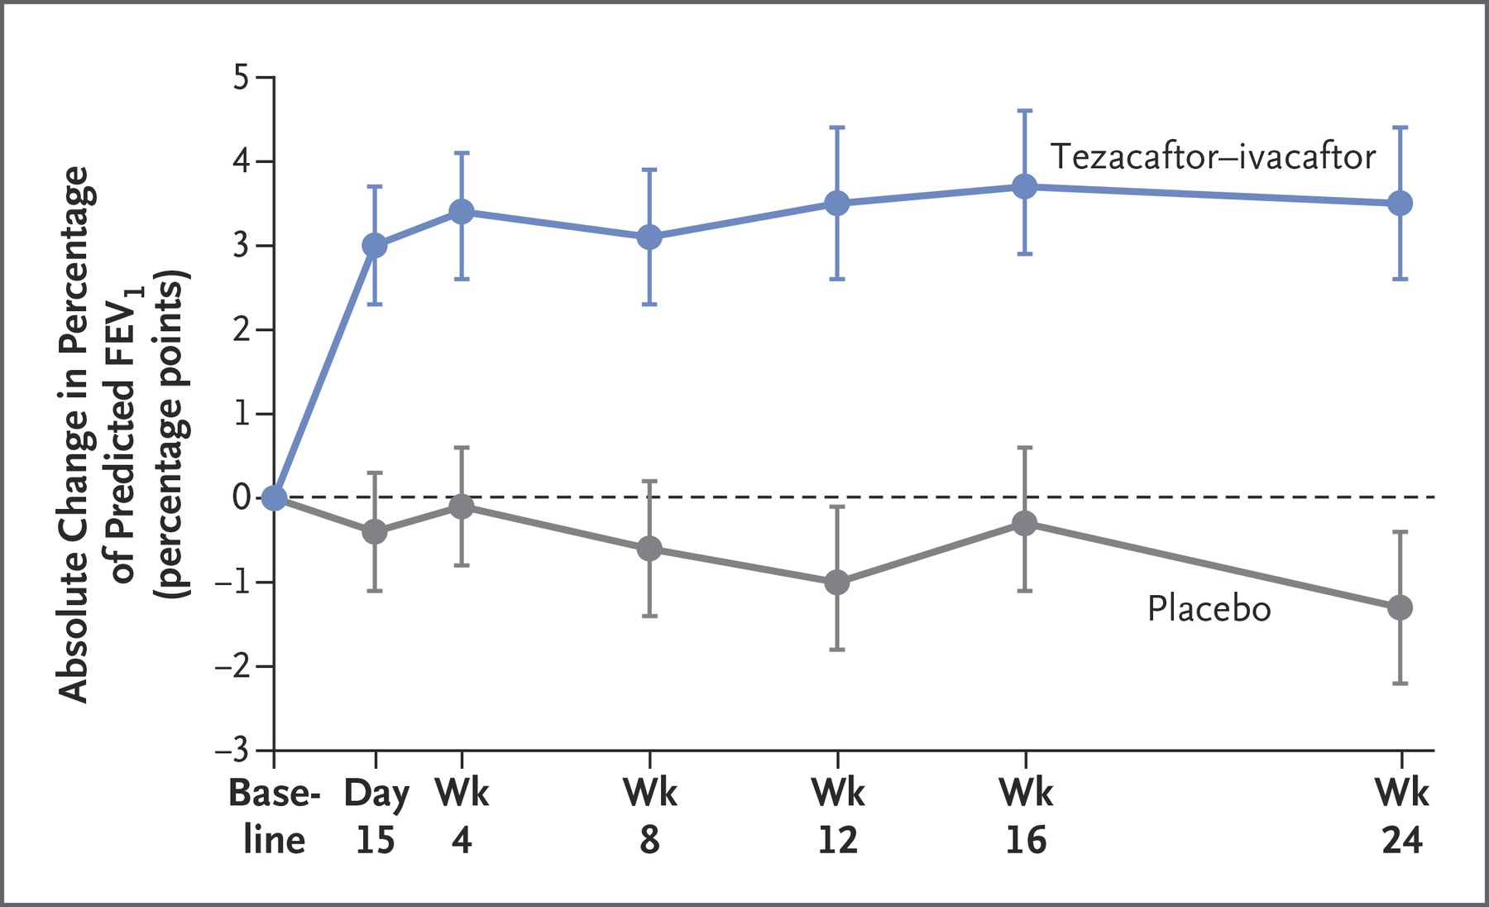
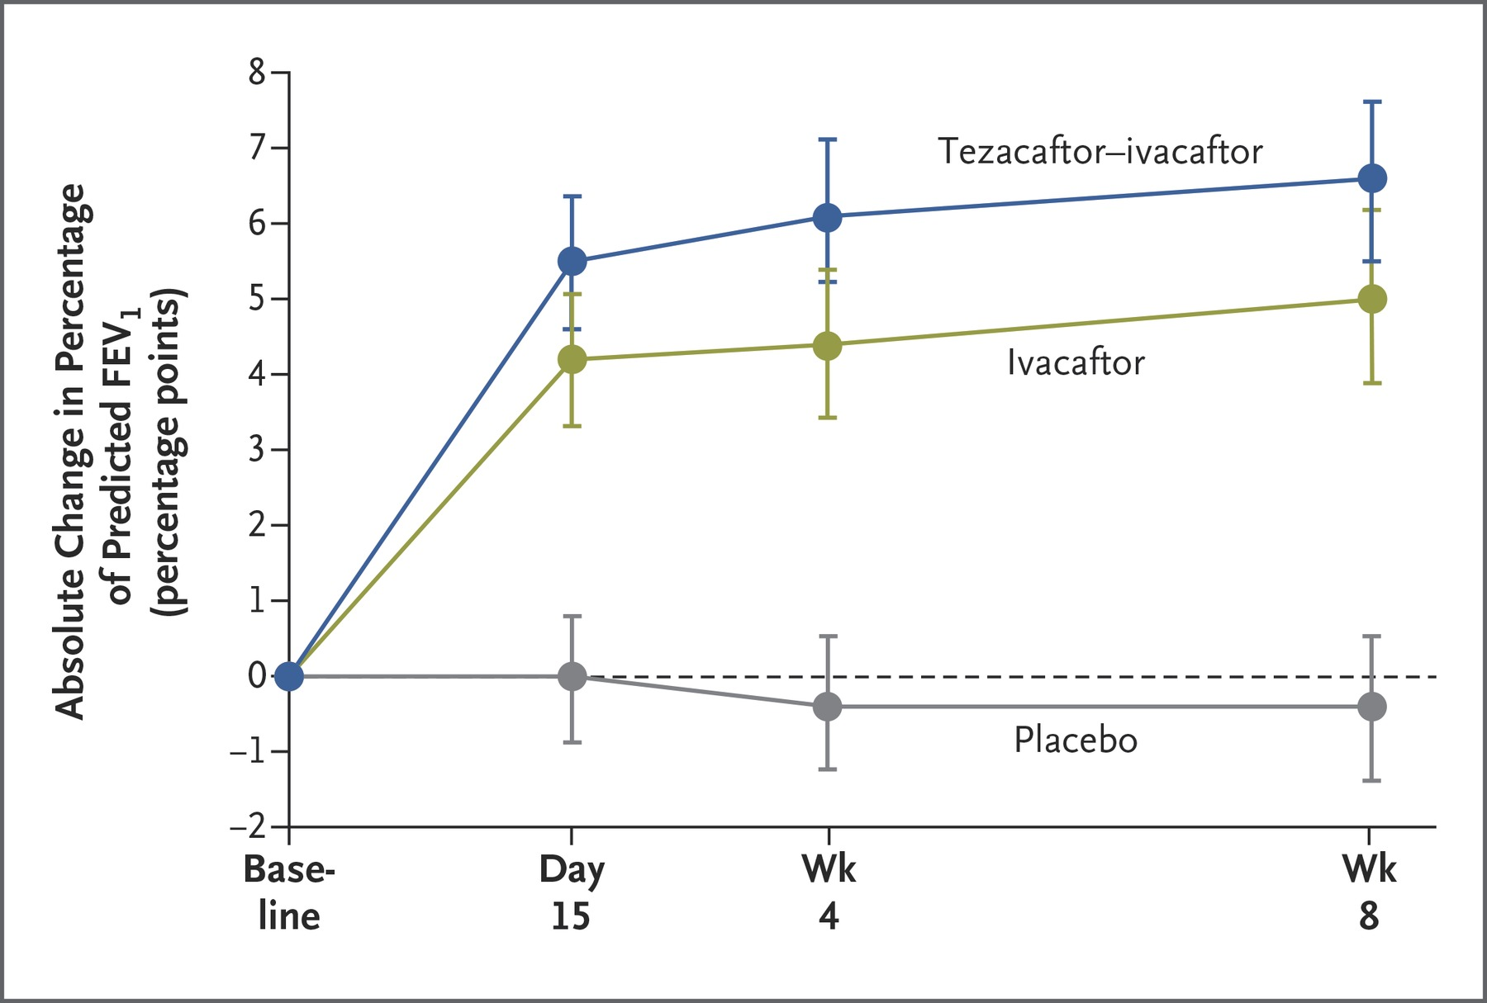
Tezacaftor and ivacaftor (Symdeko®)
Lung Function
EVOLVE study
EXPAND study
Taylor-Cousar JL, et al. N Engl J Med 2017; 377:2013-2023; Rowe SM, et al. N Engl J Med 2017; 377:2024-2035.

Slide 21
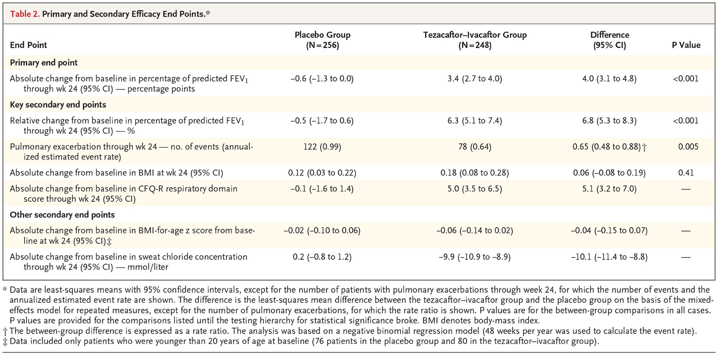
Tezacaftor and ivacaftor (Symdeko®)
35% reduction
Taylor-Cousar JL, et al. N Engl J Med 2017; 377:2013-2023; Rowe SM, et al. N Engl J Med 2017; 377:2024-2035.

Slide 22
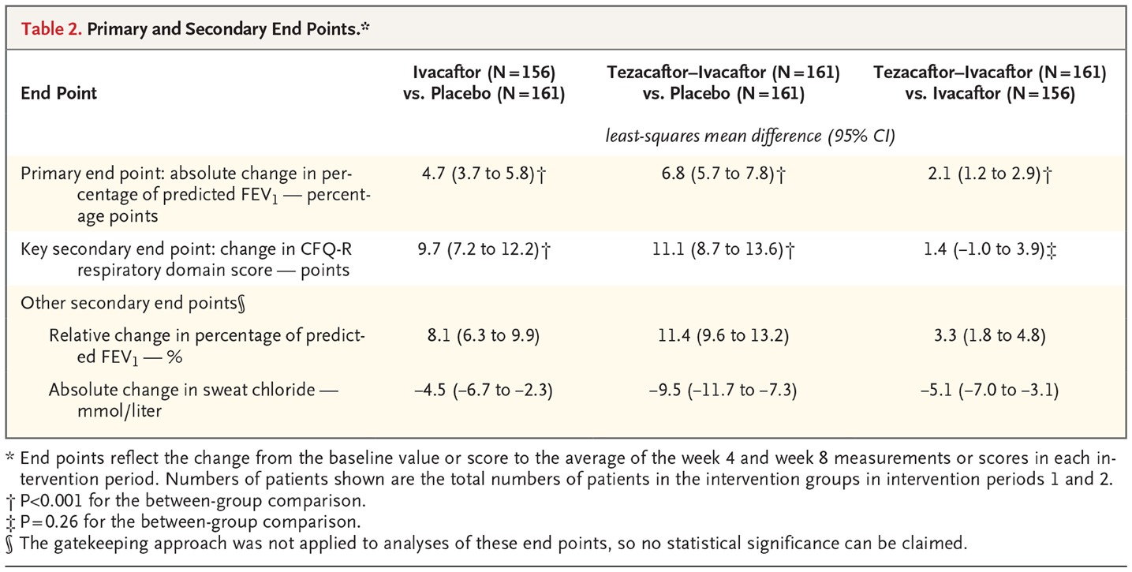
Tezacaftor and ivacaftor (Symdeko®)
Taylor-Cousar JL, et al. N Engl J Med 2017; 377:2013-2023; Rowe SM, et al. N Engl J Med 2017; 377:2024-2035.

Slide 23
Considered LOW VALUE since the drug cost is so high. For value, compared to best supportive care, the ICER = $840,568 to $974,348 per QALY gained
ICER Cystic Fibrosis Final Evidence Report.
Available at: https://icer-review.org/wpcontent/uploads/2017/10/CF_Final_Evidence_Report_06072018.pdf

Slide 24
Question 1
Biktarvy® contains the following:
A) Protease inhibitor
B) Intergrase inhibitor
C) Entry inhibitor
D) Nucleoside reverse transcriptase inhibitor
E) Nonnucleoside reverse transcriptase inhibitor
x2

Slide 25
Neurology

Slide 26
Cannabidiol (Epidiolex®)
Indication: Treatment of seizures associated with Lennox-Gastaut syndrome (LGS) or Dravet syndrome (DS) in patients 2 years of age and older
Approval Date: June 25, 2018
MOA:
CBD is a chemical component of the Cannabis sativa plant
CBD does not cause intoxication or euphoria (the “high”) that comes from tetrahydrocannabinol (THC)
SCHEDULE V SUBSTANCE
Epidiolex (cannabidiol) [prescribing information]. Carlsbad, CA: Greenwich Biosciences, Inc; June 2018.

Slide 27
Cannabidiol (Epidiolex®)
Dosage:
2.5 mg/kg twice daily
Maintenance dose: 5-10 mg/kg twice daily
ALT, AST, and total bilirubin prior to starting and monitored throughout
Precautions:
Heptaocellular injury, somnolence, suicidal behavior
Adverse Reactions: Somnolence; decreased appetite; diarrhea; transaminase elevations; fatigue, malaise, and asthenia; rash; insomnia, sleep disorder, and poor quality sleep; and infections
Epidiolex (cannabidiol) [prescribing information]. Carlsbad, CA: Greenwich Biosciences, Inc; June 2018.

Slide 28
Erenumab-aooe (Aimovig®)
Indication: Preventive treatment of migraine in adults
Approval Date: May 17, 2018
MOA:
Human monoclonal antibody that antagonizes calcitonin gene-related peptide (CGRP) receptor function
CGRP signaling plays key role in migraine pathophysiology: modulates nociceptive signaling within trigeminovascular system
Aimovig (erenumab-aooe) [prescribing information]. Thousand Oaks, CA: Amgen Inc; May 2018.
Notes:
Levels of CGRP have been shown to increase during a migraine attack.
4 agents two are approved

Slide 29
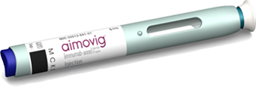
Erenumab-aooe (Aimovig®)
Dosage: 70 mg subq once a month (up to 140 mg subq once a month)
Adverse Reactions: Injection site reactions and constipation
Aimovig (erenumab-aooe) [prescribing information]. Thousand Oaks, CA: Amgen Inc; May 2018.
Notes:
Levels of CGRP have been shown to increase during a migraine attack.

Slide 30
Erenumab-aooe (Aimovig®)
Clinical Evidence
ARISE Episodic migraine; N=577
Erenumab 70 mg or placebo
Erenumab significant reduction in headache days compared to placebo
Change in headache days/month from baseline
70 mg 2.9 fewer days
Placebo 1.8 fewer days
STRIVE Phase 3 RCT episodic migraine prophylaxis
N= 955; erenumab 70 or 140 mg or placebo monthly for 6 months
Erenumab superior to placebo in reducing frequency
Change in headache days/month from baseline
70 mg 3.2 fewer days
140 mg 3.7 fewer days
Placebo 1.8 fewer days
Dodick DW, et al. Cephalagia. 2018;38(6):1026-1037.
Goadsby PJ, et al. N Engl J Med. 2017;377:2123-2132
Notes:
Chronic Migraine — Phase II Study
15 or more migraine days -6.6 vs -4.2

Slide 31
Erenumab-aooe (Aimovig®)
Clinical Evidence
LIBERTY Phase 3 RCT episodic migraine prophylaxis; failed 2-4 prevention treatment
N= 246; erenumab 140 mg or placebo monthly for 3 months
Erenumab patients had nearly three-fold higher odds of having their migraine days reduced by at least 50% compared to placebo
30.3% versus 13.7%
Aimovig (erenumab-aooe) [prescribing information]. Thousand Oaks, CA: Amgen Inc; May 2018.

Slide 32
Infectious Disease

Slide 33
Plazomicin (Zemdri®)
Indication: Treatment of complicated urinary tract infections (cUTI), including pyelonephritis in patients ≥18 years
Reserved when limited or no alternative treatments are available
Approval Date: June 25, 2018
MOA:
Aminoglycoside that acts by binding to bacterial 30S ribosomal subunit, thereby inhibiting protein synthesis
Zemdri (plazomicin) [prescribing information]. South San Francisco, CA: Achaogen, Inc; June 2018.
Notes:
in vitro activity against extended spectrum beta-lactamase (ESBL)-producing, aminoglycoside-resistant, and carbapenem-resistant isolates

Slide 34
Plazomicin (Zemdri®)
Dosage: 15 mg/kg IV every 24 hrs
Infusion over 30 mins
Boxed Warnings: Nephrotoxicity, ototoxicity, neuromuscular blockade, fatal harm
Adverse Reactions: Decreased renal function, diarrhea, hypertension, headache, nausea, vomiting and hypotension
CrCl | Dose | Frequency
60-89 ml/min | 15 mg/kg | Q24 hrs
30-59 ml/min | 10 mg/kg | Q24 hrs
15-29 ml/min | 10 mg/kg | Q48 hrs
Zemdri (plazomicin) [prescribing information]. South San Francisco, CA: Achaogen, Inc; June 2018.

Slide 35
Plazomicin (Zemdri®)
Clinical Data
Complicated Urinary Tract Infections, Including Pyelonephritis
N=609, randomized plazomicin 15 mg/kg day or meropenem 1gm q8h
Switch to oral (levofloxacin) after min 4 days IV and max 7 days IV
Analysis visit | Plazomicin n/N (%) | Meropenem n/N (%) | Treatment difference (95% CI)
Day 5 | 168/191 (88.0) | 180/197 (91.4) | -3.4 (-10.0, 3.1)
Clinical cure or improvement | 171/191 (89.5) | 182/197 (92.4)
Microbiological eradication | 188/191 (98.4) | 193/197 (98.0)
TOC | 156/191 (81.7) | 138/197 (70.1) | 11.6 (2.7, 20.3)
Clinical Cure | 170/191 (89.0) | 178/197 (90.4)
Microbiological eradication | 171/191 (89.5) | 147/197 (74.6)
Zemdri (plazomicin) [prescribing information]. South San Francisco, CA: Achaogen, Inc; June 2018.

Slide 36
Question 2
Aimovig® is indicated for treatment of:
A) Chronic migraine
B) Episodic migraine
C) Tension headache
D) Cluster headache

Slide 37
Immune Modulators

Slide 38
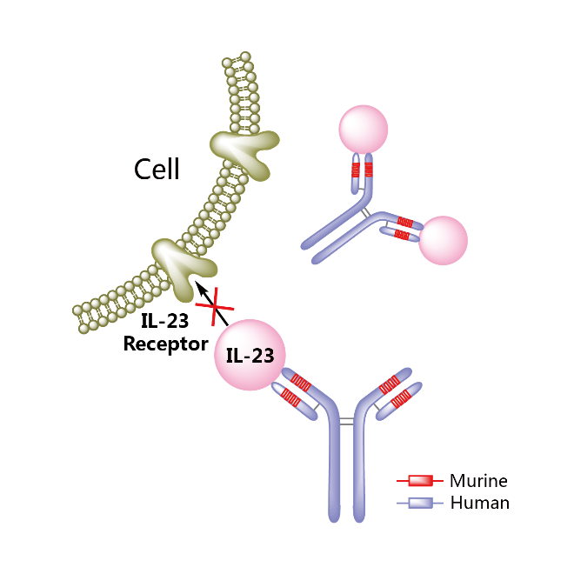
Tildrakizumab (Ilumya®)
Indication: Treatment of moderate to severe plaque psoriasis
Approval Date: March 20, 2018
MOA:
Monoclonal antibody to inhibit interleukin 23
Ilumya (tildrakizumab-asmn) [prescribing information]. Whitehouse Station, NJ: Merck & Co Inc; March 2018.
Notes:
Cytokines play key roles in controlling cell growth and the immune response. Many cytokines function by binding to and activating type I and type II cytokine receptors. These receptors in turn rely on the Janus kinase (JAK) family of enzymes for signal transduction. Hence drugs that inhibit the activity of these Janus kinases block cytokine signalling.

Slide 39
Tildrakizumab (Ilumya®)
Dosage: 100 mg subq on Week 0 and 4, then every 12 weeks
Adverse Reactions:
Upper respiratory tract infections, infections, injection site reactions, antibody development
Ilumya (tildrakizumab-asmn) [prescribing information]. Whitehouse Station, NJ: Merck & Co Inc; March 2018.

Slide 40
Tildrakizumab (Ilumya®)
Clinical Evidence:
reSURFACE 1 & 2
N=1862 patients
Tildrakizumab 100 or 200 mg, placebo, etanercept [reSURFACE2]
Reich K, et al. Lancet 2017;390:276-88.

Slide 41
Tildrakizumab (Ilumya®)
Clinical Evidence:
Tildrakizumab 200 mg significantly more achieved PASI and PGA response compared to etanercept
Tildrakizumab response was maintained at Week 28
Reich K, et al. Lancet 2017;390:276-88.

Slide 42
ICER Psoriasis Report-at-a-Glance.
Available at: https://icer-review.org/wp-content/uploads/2018/08/ICER_Psoriasis_RAAG_080318.pdf

Slide 43
Baricitinib (Olumiant®)
Indication: Treatment of moderately to severely active rheumatoid arthritis who have had an inadequate response to one or more TNF antagonist therapies
Approval Date: June 1, 2018
MOA:
Janus kinase (JAK) inhibitor
Cytokines --- immune response
JAK enzymes --- signal transduction
Inhibiting JAK blocks cytokine signaling
Olumiant (baricitinib) [prescribing information]. Indianapolis, IN: Lilly USA LLC; June 2018.
Notes:
Cytokines play key roles in controlling cell growth and the immune response. Many cytokines function by binding to and activating type I and type II cytokine receptors. These receptors in turn rely on the Janus kinase (JAK) family of enzymes for signal transduction. Hence drugs that inhibit the activity of these Janus kinases block cytokine signalling.

Slide 44
Baricitinib (Olumiant®)
Dosage: 2 mg oral daily
Monotherapy or in combination with methotrexate or other DMARDs
Anemia: Avoid initiation or interrupt -- hemoglobin <8 g/dL
Lymphopenia: Avoid initiation or interrupt -- Absolute Lymphocyte Count <500 cells/mm³
Boxed Warnings:
Serious infections (tuberculosis)
Malignancies (lymphomas)
Thrombosis
Adverse Reactions:
Upper respiratory tract infections, nausea, herpes simplex, and herpes zoster
Olumiant (baricitinib) [prescribing information]. Indianapolis, IN: Lilly USA LLC; June 2018.

Slide 45
Baricitinib (Olumiant®)
RA-BEACON
Mod-Sev RA w/ inadequate response to TNFi (n=527)
RA-BUILD
Mod-Sev RA w/ inadequate response to cDMARD never received biologic (n=684)
Baricitinib 2 or 4 mg or placebo (cDMARD allowed)
Baricitinib 2 or 4 mg or placebo (cDMARD allowed)
RA-BEGIN
Mod-Sev RA w/ limited cDMARD therapy never received biologic (n=584)
Baricitinib 4 mg +/- MTX or MTX
RA-BEAM
Mod-Sev RA w/ inadequate response to MTX never received biologic (n=684)
Baricitinib 4 mg, adalimumab 40 mg or placebo (MTX allowed)
Genovese MC, et al. N Engl J Med 2016; 374:1243-1252 Dougados M, et al. Ann Rheum Dis, 76(1), 88-95
Fleischmann R, et al. Arthritis Rheumatol. 2017. 69(3): 506–517. Taylor PC, et al. N Engl J Med 2017; 376:652-662.

Slide 46
Baricitinib (Olumiant®)
 | BAR 2 mg | BAR 4 mg | PLB | BAR 4 mg + MTX | MTX | ADA
ACR 20 @ wk 12
RA-BEACON | 49% | 55% | 27%
RA-BUILD | 62% | 66% | 39%
RA-BEGIN |  | 77% |  |  | 62%
RA-BEAM |  | 70% | 40% |  |  | 60%
ACR 50 @ wk 12
RA-BEACON | 20% | 28% | 8%
RA-BUILD | 34% | 33% | 13%
RA-BEGIN |  | 60% |  | 63% | 43%
RA-BEAM |  | 45% |  |  |  | 35%
ACR 70 @ wk 12
RA-BEACON | 13% | 11% | 2%
RA-BUILD | 18% | 18% | 3%
RA-BEGIN |  | 42% |  | 40% | 21%
RA-BEAM |  | 19% |  |  |  | 13%
Genovese MC, et al. N Engl J Med 2016; 374:1243-1252 Dougados M, et al. Ann Rheum Dis, 76(1), 88-95
Fleischmann R, et al. Arthritis Rheumatol. 2017. 69(3): 506–517. Taylor PC, et al. N Engl J Med 2017; 376:652-662.
Notes:
Interestingly, MTX in combination with baricitinib did not appear to increase the benefit observed with baricitinib monotherapy in terms of response rates.

Slide 47
Other

Slide 48
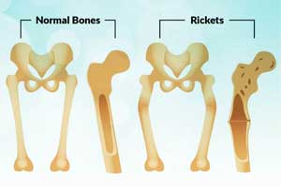
Burosumab-twza (Crysvita®)
Indication: Treatment of adults and children ages 1 year and older with x-linked hypophosphatemia (XLH)
Approval Date: April 17, 2018
MOA:
Binds to and inhibits the activity of fibroblast growth factor 23 (FGF23)
Restoring renal phosphate reabsorption and increasing the serum concentration of 1,25 dihydroxy vitamin D
Crysvita (burosumab-twza) [prescribing information]. Novato, CA: Ultragenyx Pharmaceutical Inc; April 2018.

Slide 49
Burosumab-twza (Crysvita®)
Dosage:
Adult: 1 mg/kg SC every 4 weeks; max dose 90 mg
Pediatric: 0.8 mg/kg SC every 4 weeks; max dose 90 mg
Titrate dose based on phosphorus response
Precautions: Hypersensitivity, hyperphosphatemia and risk of nephrocalcinosis, and injection site reactions
Adverse Reactions: Back pain, headache, tooth infection, restless leg syndrome, vitamin D decreased, dizziness, constipation, blood phosphorus increased
Crysvita (burosumab-twza) [prescribing information]. Novato, CA: Ultragenyx Pharmaceutical Inc; April 2018.

Slide 50
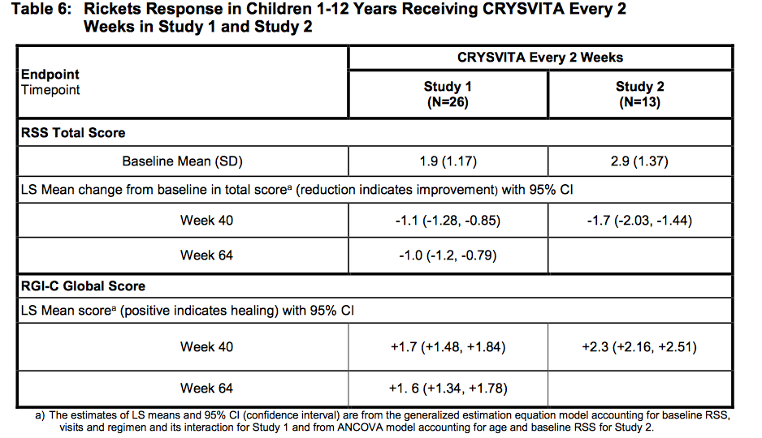
Burosumab-twza (Crysvita®)
Study 1 & 2
Pediatric X-linked hypophosphatemia (N=65)
Crysvita (burosumab-twza) [prescribing information]. Novato, CA: Ultragenyx Pharmaceutical Inc; April 2018.
Notes:
The higher the RSS score the greater rickets severity and the higher the RGI-C score the greater improvement in radiographic evidence of rickets.

Slide 51
Burosumab-twza (Crysvita®)
Study 3 & 4
Adult X-linked hypophosphatemia (N=147)
Crysvita (burosumab-twza) [prescribing information]. Novato, CA: Ultragenyx Pharmaceutical Inc; April 2018.
Notes:
The higher the RSS score the greater rickets severity and the higher the RGI-C score the greater improvement in radiographic evidence of rickets.

Slide 52
Sodium Zirconium Cyclosilicate (Lokelma®)
Indication: Treatment of hyperkalemia in adults
Approval Date: May 18, 2018
MOA:
Binds potassium reducing the concentration of free potassium in the gastrointestinal lumen, lowering serum potassium levels
Lokelma (sodium zirconium cyclosilicate) [prescribing information]. Wilmington, DE: AstraZeneca Pharmaceuticals LP; May 2018.
Notes:
Patiromer
Sodium Polystyrene Sulfonate
Sodium Zirconium Cyclosilicate

Slide 53
Sodium Zirconium Cyclosilicate (Lokelma®)
Dosage: Initially 10 gm 3 times daily up to 1st 48 hrs; then 5 gm every other day to 15 gm once daily maintenance
Adverse Reactions: Edema and hypokalemia
Lokelma (sodium zirconium cyclosilicate) [prescribing information]. Wilmington, DE: AstraZeneca Pharmaceuticals LP; May 2018.

Slide 54
Elagolix sodium (Orilissa®)
Indication: Management of moderate to severe pain associated with endometriosis
Approval Date: July 23, 2018
MOA:
GnRH receptor antagonist
Dose-dependent suppression of LH and FSH release
Rapid return to pre-treatment levels when therapy stopped
Orilissa (elagolix) [prescribing information]. North Chicago, IL: AbbVie Inc; July 2018.

Slide 55
Elagolix sodium (Orilissa®)
Dosage:
Endometriosis – 150 mg oral daily (24 months max duration)
Endometriosis w/dyspareunia – 200 mg oral daily (6 months max duration)
Warnings/Precautions:
Bone loss, decreased ability to recognize pregnancy, mood disorders, ALT elevations, decreased efficacy of oral contraceptives
Adverse Reactions:
Hot flushes and night sweats, headache, nausea, insomnia, amenorrhea, anxiety, arthralgia, depression-related adverse reactions and mood changes
Orilissa (elagolix) [prescribing information]. North Chicago, IL: AbbVie Inc; July 2018.
Notes:
Limit the duration of use because of bone loss

Slide 56
Elagolix sodium (Orilissa®)
Clinical Evidence
Elaris EM I & II trials (DB, PC, phase 3 RCT)
Elagolix 150 or 200 mg or placebo for 6 months
N=872
Results:
3 months: Both elagolix doses results in great reduction in dysmenorrhea and nonmenstrual pelvic pain compared to placebo
Response sustained at month 6
Higher patient reported improvement with elagolix
Taylor HS, et al. N Engl J Med 2017; 377:28-40.

Slide 57
Lofexidine (Lucemyra®)
Indication: Mitigation of opioid withdrawal symptoms to facilitate abrupt opioid discontinuation in adults
Approval Date: May 16, 2018
MOA:
Central alpha-2 adrenergic agonist that reduces the release of norepinephrine and decreases sympathetic tone
Lofexidine is thought to be associated with less anti-hypertensive activity than clonidine (high selectivity for the alpha-2A receptor)
Lucemyra (lofexidine) [prescribing information]. Louisville, KY: US WorldMeds, LLC; May 2018.
Notes:
Lucemyra, also known as lofexidine hydrochloride, was originally intended to be a hypertension medication. It acts to reduce the release of norepinephrine, a hormone that increases heart rate and blood pressure.
LUCEMYRA is not an opioid drug and is not a treatment for opioid use disorder

Slide 58
Lofexidine (Lucemyra®)
Dosage: Initial: 0.54 mg 4 times daily (every 5 to 6 hours) during peak withdrawal symptoms (generally the first 5 to 7 days after last opioid use)
May continue up to 14 days
Gradually taper dose to discontinue
Warning/Precautions:
CV effects (syncope/decreases in BP and/or HR)
CNS depression
QT prolongation
CYP2D6 poor metabolizers (increase exposure)
Lucemyra (lofexidine) [prescribing information]. Louisville, KY: US WorldMeds, LLC; May 2018.

Slide 59
Lofexidine (Lucemyra®)
Clinical Evidence
Lofexidine vs placebo; N=264
Lofexidine decreased withdrawal symptoms versus placebo (short opioid withdrawal scale scores on day 3)
Lofexidine vs diazepam; N=108
Lofexidine was at least as effective as diazepam in reducing withdrawal symptoms
Cochrane Review
Lofexidine does not reduce BP to the same extent as clonidine but is otherwise similar ability to ameliorate withdrawal symptoms
Guo S, et. al. J Subst Abuse Treat. 2018;91:1-11.
Gorodetzky CW, et. al. Drug Alcohol Depend. 2017;176:79-88. (Study 1)
Gowing L, et. al. Cochrane Database of Systematic Reviews. 2016. Doi: 10.1002/14651858.CD002024.pub5

Slide 60
Oncology/Hematology

Slide 61
Fostamatinib (Tavalisse®)
Indication: Treatment of thrombocytopenia in adult patients with chronic immune thrombocytopenia (ITP) who have had an insufficient response to a previous treatment
Approval Date: April 17, 2018
MOA:
Spleen tyrosine kinase (Syk) inhibitor
Reduces antibody-mediated destruction of platelets
Tavalisse (fostamatinib) [prescribing information]. South San Francisco, CA: Rigel Pharmaceuticals, Inc; April 2018.

Slide 62
Fostamatinib (Tavalisse®)
Dosage:
100 mg orally BID
Can increase to 150 mg BID if platelets do not increase to at least 50,000/mm³ after 1 month
Precautions: Hypertension, hepatotoxicity, diarrhea, and neutropenia
Adverse Reactions: Diarrhea, hypertension, nausea, respiratory infection, dizziness, ALT/AST increased, rash, abdominal pain, fatigue, chest pain and neutropenia
Tavalisse (fostamatinib) [prescribing information]. South San Francisco, CA: Rigel Pharmaceuticals, Inc; April 2018.

Slide 63
Fostamatinib (Tavalisse®)
Clinical Evidence
FIT1 & FIT2
Failed splenectomy, thrombopoietic agents, and/or rituximab
Allowed to continue one of the following (corticosteroids at <20 mg prednisone equivalent per day, azathioprine, or danazol)
Platelet counts >50 000/µL on at least 4/6 clinic visits occurring every 2 weeks during weeks 14–24
Bussel J et al. Am J Hematol. 2018 Jul;93(7):921-930.

Slide 64
Avatrombopag (Doptelet®)
Indication: Treatment of thrombocytopenia in adult patients with chronic liver disease who are scheduled to undergo a procedure
Approval Date: May 21, 2018
MOA:
Thrombopoietin (TPO) receptor agonists
Stimulates proliferation and differentiation of megakaryocytes resulting in an increase in platelet production
Additive effect
Doptelet (avatrombopag) [prescribing information]. Durham, NC: Dova Pharmaceuticals, Inc; May 2018.
Notes:
Avatrombopag does not compete with TPO for binding at the TPO receptor and has an additive effect with TPO on platelet production.

Slide 65
Avatrombopag (Doptelet®)
Dosage:
Precautions: Thromboembolism (portal vein thrombosis)
Adverse Reactions: Pyrexia, abdominal pain, nausea, headache
Platelet count
40,000 - <50,000/mm³ | 40 mg once daily w/food | 5 consecutive days
<40,000/mm³ | 60 mg once daily w/food
Doptelet (avatrombopag) [prescribing information]. Durham, NC: Dova Pharmaceuticals, Inc; May 2018.
Notes:
Factor V Leiden, prothrombin 20210A, antithrombin deficiency or protein C or S deficiency

Slide 66
Avatrombopag (Doptelet®)
Primary endpoint: No need for transfusion/any rescue procedure for bleeding up to 7 days following procedure
Doptelet (avatrombopag) [prescribing information]. Durham, NC: Dova Pharmaceuticals, Inc; May 2018.
Notes:
Factor V Leiden, prothrombin 20210A, antithrombin deficiency or protein C or S deficiency

Slide 67
Avatrombopag (Doptelet®)
Significant reduction in the need for platelet transfusion or any rescue procedure for bleeding compared to placebo
40 mg: ADAPT-1, 88% vs. 38%, p <0.0001; ADAPT-2, 88% vs. 33%; p<0.0001
60 mg: ADAPT-1, 66% vs. 23%, p <0.0001; ADAPT-2, 69% vs. 35%; p=0.0006
Significantly more patients achieved platelet count of ≥50,000/µL on day of procedure compared to placebo
Significantly more patients had an increase in platelet count on procedure day compared to placebo
Mean platelet count peaked 10-13 days after start of treatment and returned to near baseline after 35 days
Doptelet (avatrombopag) [prescribing information]. Durham, NC: Dova Pharmaceuticals, Inc; May 2018.
Notes:
plans to submit a supplemental NDA to FDA for the treatment of chronic immune thrombocytopenia purpura (ITP) in the second half of 2018. Work is also ongoing for evaluation of DOPTELET in the treatment of chemotherapy-induced thrombocytopenia (CIT) and for the treatment of thrombocytopenia in patients undergoing more invasive surgical procedures

Slide 68
Lusutrombopag (Mulpleta®)
Indication: Treatment of thrombocytopenia in adult patients with chronic liver disease who are scheduled to undergo a procedure
Approval Date: July 31, 2018
MOA:
Thrombopoietin (TPO) receptor agonists
Stimulates proliferation and differentiation of megakaryocytes resulting in an increase in platelet production
Mulpleta (lusutrombopag) [prescribing information]. Japan: Shionogi, Inc; July 2018.
Notes:
Avatrombopag does not compete with TPO for binding at the TPO receptor and has an additive effect with TPO on platelet production.

Slide 69
Lusutrombopag (Mulpleta®)
Dosage:
3 mg orally daily for 7 days
8-14 days prior to procedure
Procedure 2-8 days following last dose
Precautions: Thromboembolism (portal vein thrombosis)
Adverse Reactions: Headache
Mulpleta (lusutrombopag) [prescribing information]. Japan: Shionogi, Inc; July 2018.
Notes:
Factor V Leiden, prothrombin 20210A, antithrombin deficiency or protein C or S deficiency

Slide 70
Lusutrombopag (Mulpleta®)
Clinical Evidence
L-PLUS 1 (n=97) & L-PLUS 2 (N=215)
CLD + platelet count < 50 x 10⁹ L + invasive procedure
Lusutrombopag 3 mg or placebo up to 7 day
Endpoint | L-PLUS 1 |  | L-PLUS 2
 | Mulpleta (N=49) | Placebo (N=48) | Mulpleta (N=108) | Placebo (N=107)
Not requiring platelet transfusion prior to invasive procedure, n(%) | 38 (78) | 6 (13) | 70 (65) | 31 (29)
Treatment difference (95% CI), p value | 64 (49, 79) <0.0001 |  | 37 (25, 49) <0.0001
Responder during study, n(%) | 37 (76) | 3 (6) | 70 (65) | 14 (13)
Treatment difference (95% CI), p value | 68 (54, 82) <0.0001 |  | 52 (41, 62) <0.0001
Mulpleta (lusutrombopag) [prescribing information]. Japan: Shionogi, Inc; July 2018.
Notes:
Platelet count reached at least 50 x 109/L and increased at least 20 x 109/L from baseline.

Slide 71
Apalutamide (Erleada®)
Indication: Treatment of non-metastatic, castration-resistant prostate cancer (NM-CRPC)
Approval Date: February 14, 2018
MOA:
Nonsteroidal androgen receptor inhibitor
Androgen receptor inhibition results in decreased proliferation of tumor cells and increased apoptosis, leading to a decrease in tumor volume
Erleada (apalutamide) [prescribing information]. Horsham, PA: Janssen Products, LP; February 2018.
Notes:
Prostate cancers are generally responsive to androgen, and, at least initially, typically respond to androgen deprivation therapy (ADT).3 ADT involves medical or surgical castration. Medications used for ADT include gonadotropin releasing hormone (GnRH) agonists, such as leuprolide, goserelin, and triptorelin,4 and GnRH antagonists, such as degarelix.5
ADT is used in a number of clinical settings, including disseminated prostate cancer, high-risk prostate cancer treated with radiation therapy, and prostate cancer treated with radical prostatectomy found to have positive pelvic nodes.6 Prostate cancer that has not been treated with ADT or that is responding to ADT is called “castration sensitive”. Over time, most cancers that were castration sensitive become castration resistant. Castration-resistant prostate cancer (CRPC) is defined as prostate cancer that progresses clinically, radiographically, or biochemically despite ADT that has achieved low (castrate) levels of serum testosterone.6
Patients with metastatic disease who progress on ADT or who develop metastatic disease on ADT benefit from treatment with antiandrogen therapies.3
Antiandrogens include abiraterone acetate (Zytiga®; Janssen Biotech, Inc.), enzalutamide (Xtandi®; Astellas Pharma, Inc.), and apalutamide (Erleada™; Janssen Biotech, Inc.).
Abiraterone is an androgen biosynthesis inhibitor that inhibits 17 α-hydroxylase/C17,20-lyase (CYP17), which is expressed in testicular, adrenal, and prostatic tumor tissues; abiraterone acetate must be administered with corticosteroids (typically prednisone). 3,7
Enzalutamide and apalutamide are androgen receptor inhibitors that bind to the ligand-binding domain of the androgen receptor.8,9
In July 2018, enzalutamide is expected to be FDA-reviewed for nmCRPC.
Abiraterone acetate has not been studied in this specific population in a RCT, but a phase 2 trial suggested efficacy in this population.

Slide 72
Apalutamide (Erleada®)
Dosage: 240 mg (4 60 mg tablets) daily (in combination with a gonadotropin-releasing hormone analog agonist or antagonist)
Precautions:
Falls and fractures (16% and 12% of patients, respectively)
Seizures (0.2% of patients)
Adverse Reactions: Fatigue, hypertension, rash, diarrhea, nausea, weight decreased, arthralgia, fall, hot flush, decreased appetite, fracture, and peripheral edema
Erleada (apalutamide) [prescribing information]. Horsham, PA: Janssen Products, LP; February 2018.

Slide 73
Apalutamide (Erleada®)
Smith, M. R, et al. N Engl J Med 2018; 378:1408-1418.
Koukourakis, M. I., et al. Anti-cancer drugs, 29(4), 323-333.
Notes:
This approval is the first to use the endpoint of metastasis-free survival

Slide 74
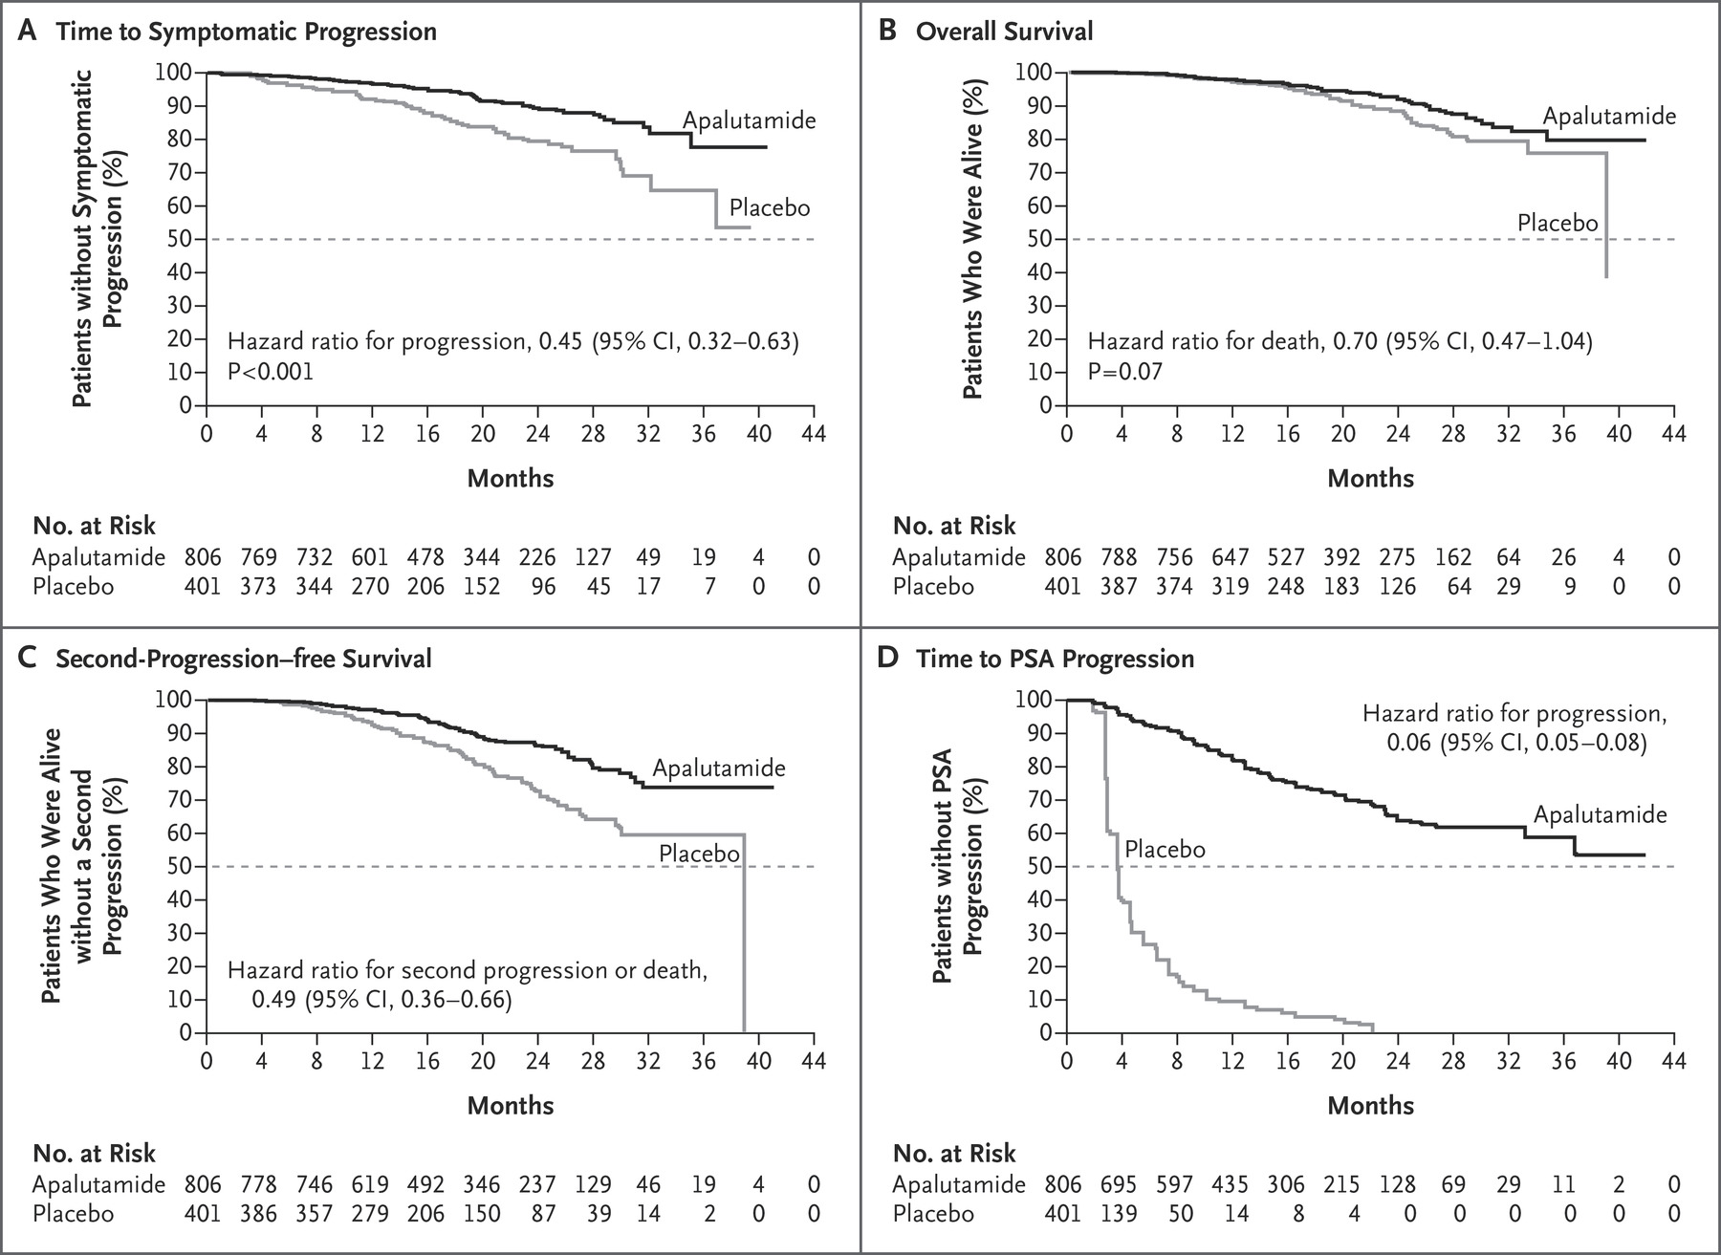
Apalutamide (Erleada®)
Smith, M. R, et al. N Engl J Med 2018; 378:1408-1418.
Notes:
This approval is the first to use the endpoint of metastasis-free survival

Slide 75
Ivosidenib (Tibsovo®)
Indication: Treatment of adult patients with relapsed or refractory acute myeloid leukemia (AML) with a susceptible isocitrate dehydrogenase-1 (IDH1) mutation
Approval Date: July 20, 2018
MOA:
Targets and inhibits the activity of the orthopoxvirus VP37 protein
Prevents cell-to-cell and long-range dissemination of virus
Tibsovo (ivosidenib) [prescribing information]. Cambridge, MA: Agios Pharmaceuticals, Inc; July 2018.
Notes:
IDH1 mutations occur in approximately 6 to 10% of the patients with AML

Slide 76
Ivosidenib (Tibsovo®)
Dosage: 500 mg orally once daily
Avoid high fat meal
Boxed Warnings:
Differentiation syndrome
Warnings/Precautions:
QTc prolongation and Guillain-Barre syndrome
Adverse Reactions:
Fatigue, leukocytosis, arthralgia, diarrhea, dyspnea, edema, nausea, mucositis, electrocardiogram QT prolonged, rash, pyrexia, cough, and constipation
Tibsovo (ivosidenib) [prescribing information]. Cambridge, MA: Agios Pharmaceuticals, Inc; July 2018.

Slide 77
Ivosidenib (Tibsovo®)
Clinical Evidence:
Single arm trial; N=174
Median follow-up 8.3 months
32.8% of patients experienced complete remission or complete remission with partial hematologic recovery lasting a median of 8.2 months
110 patients were dependent of RBC and/or platelet transfusions at baseline
37.3% did not require transfusion during 56 day post-baseline period
Tibsovo (ivosidenib) [prescribing information]. Cambridge, MA: Agios Pharmaceuticals, Inc; July 2018.

Slide 78
Question 3
Which of the following reduces antibody-mediated destruction of platelets?
A) Avatrombopag
B) Fostamatinib
C) Lusutrombopag
D) All of the above

Slide 79
Fosnetupitant and Palonosetron (Akynzeo®)
Indication: Prevention of acute and delayed nausea and vomiting associated with highly emetogenic chemotherapy
Approval Date: April 20, 2018
MOA:
Neurokinin (NK₁) receptor antagonist
Selective 5-HT₃ receptor antagonist
Work synergistically to inhibit substance P response
Akynzeo (fosnetupitant and palonosetron) [prescribing information]. Iselin, NJ: Helsinn Therapeutics (US), Inc; April 2018.
Notes:
AKYNZEO capsules is indicated in combination with dexamethasone in
adults for the prevention of acute and delayed nausea and vomiting
associated with initial and repeat courses of cancer chemotherapy,
including, but not limited to, highly emetogenic chemotherapy.
Limitations of use: Has not been studied for the prevention of nausea and vomiting associated with anthracycline plus cyclophosphamide (AC) chemotherapy

Slide 80
Fosnetupitant and Palonosetron (Akynzeo®)
Dosage:
Fosnetupitant 235 mg and palonosetron 0.25 mg 30 mins prior the chemotherapy on day 1
PLUS dexamethasone 12 mg day 1, then 8 mg days 2-4
Adverse Reactions: Hypersensitivity and serotonin syndrome
Akynzeo (fosnetupitant and palonosetron) [prescribing information]. Iselin, NJ: Helsinn Therapeutics (US), Inc; April 2018.

Slide 81
Fosnetupitant and Palonosetron (Akynzeo®)
Clinical Evidence:
Based on oral formulation
Akynzeo had improve response (acute and delayed phase) compared to palonsetron alone
Formulation | Price/unit (AWP)
Capsule | $688.80
Injection | $612.00
Akynzeo (fosnetupitant and palonosetron) [prescribing information]. Iselin, NJ: Helsinn Therapeutics (US), Inc; April 2018.

Slide 82
Questions

