Slide 1
Practices and Principles of Leadership
Josh Bright, PharmD
Drew Jensen, PharmD
North Arkansas Regional Medical Center

Slide 2
Disclosure
The presenters have no conflicts of interest, real or apparent, and no financial interests in any company, product, or service to disclose.

Slide 3
Objectives
Define the concept of the everyday leader
Discuss the leadership practice of active listening
Understand the principle of servant leadership
Recognize the importance of thinking gray and thinking free

Slide 4
“Take me to your leader.”

Slide 5
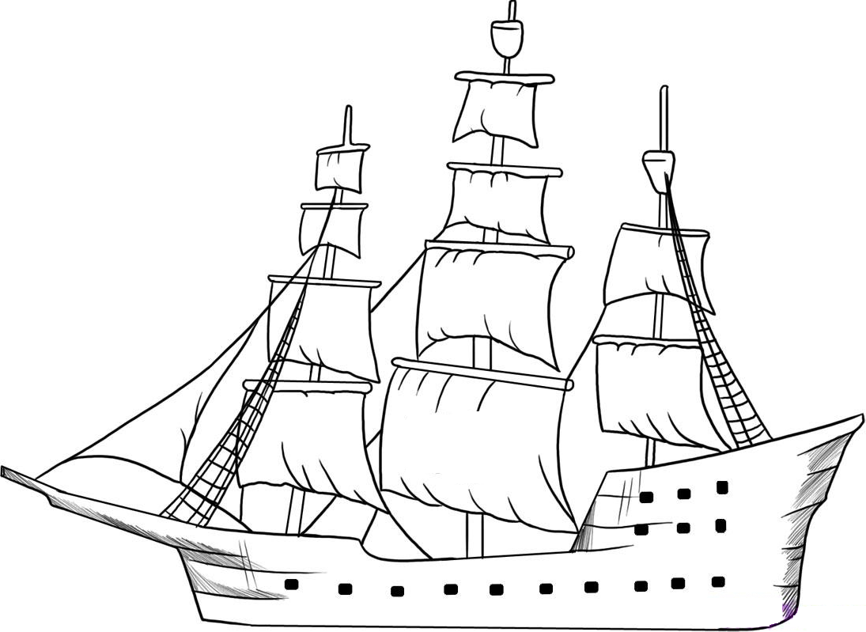
The captain goes down with the ship.

Slide 6
“Leaders are willing to do what 99.9% of humanity is not: make decisions and take responsibility for them.
I personally can’t think of a worse way to spend my day.”
-John Cadley

Slide 7
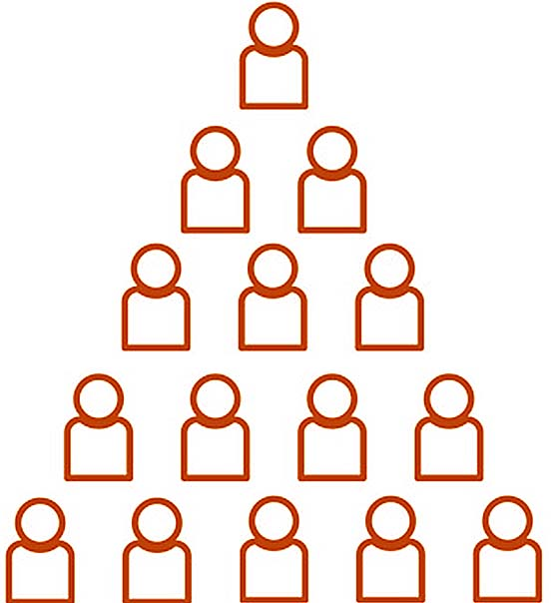
Everyday leadership
Drew Dudley
https://www.youtube.com/watch?v=uAy6EawKKME

Slide 8
Leading with Lollipops

Slide 9
“The average person suffers from three delusions:
that he is a good driver,
that he has a good sense of humor, and
that he is a good listener.”
-Steven Sample

Slide 10
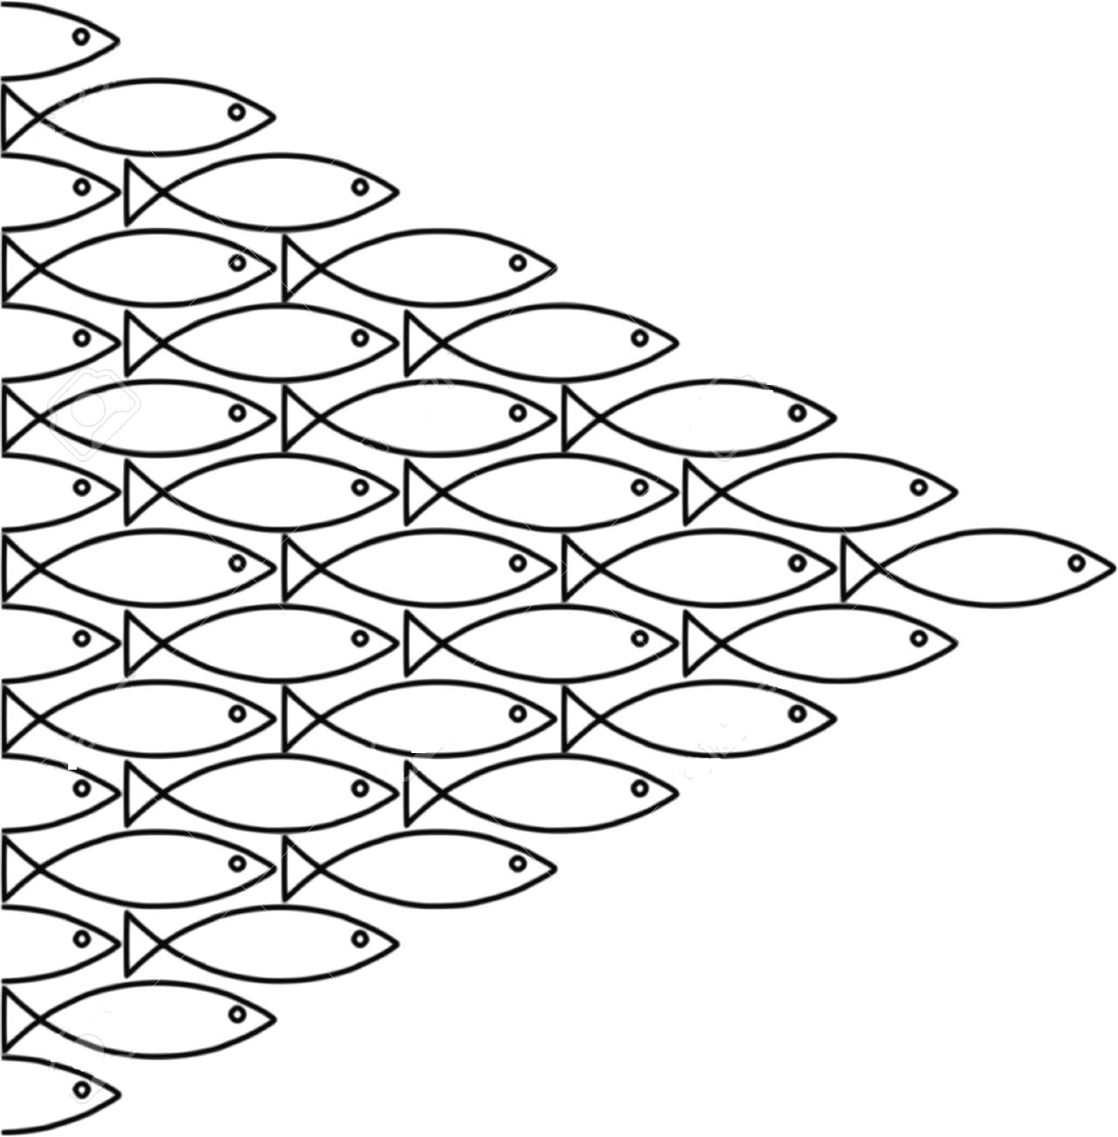
Defining a Tribe
A group of between 20 and 150 people

Slide 11
“No point in values.”
“It’s not fair.”
“Life sucks.”
Stage 1

Slide 12
“That’s not
possible.”
“It’s against policy.”
“My life sucks.”
Stage 2

Slide 13
“I’m great!
(and you’re not).”
“I / Me / Mine.”
Stage 3

Slide 14
Stage 4
“We’re the
best!”

Slide 15
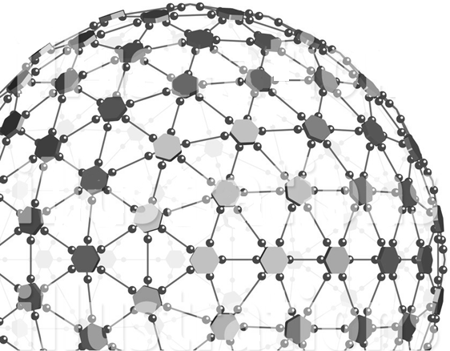
“Life is
great!”
“We did the
impossible.”
“A miracle.”
Stage 5

Slide 16
What percentage of your time is spent helping your direct reports succeed?
< 20%
20-39%
40-59%
60-79%
> 80%

Slide 17
“Hi. My name is Herb Kelleher. Thank you for flying my airline. Can I get you something to drink?”

Slide 18
“If you’re not in the process of getting rid of a lieutenant, bend over backward to help him get his job done.”
-Steven Sample

Slide 20
Dangers of “Binary thinking”
① Closing your mind to future ideas
② Flip-flopping
③ Group think

Slide 21
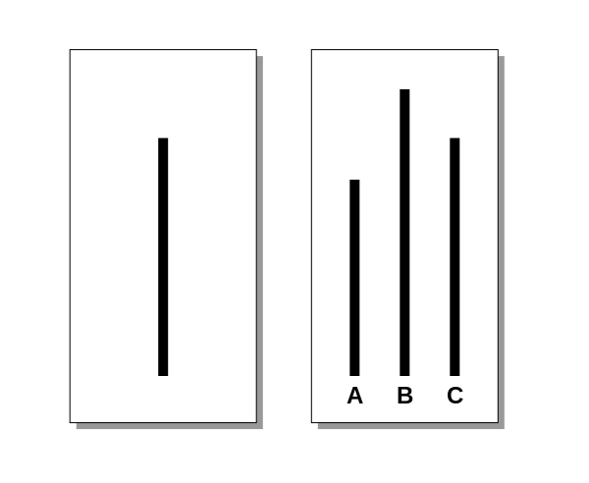
The card on the left is for reference, the one on the right shows the comparison lines.
Notes:
“The tendency to conformity in our society is so strong that reasonably intelligent and well-meaning young people are willing to call white black. This is a matter of concern.”
-Solomon Asch

Slide 22
(if only you try)

Slide 24
References
Asch, Solomon. Opinions and Social Pressure. Scientific American, November 1955, Volume 193, No. 5, pp. 31-35.
Cadley, John. Leadership. Toastmaster Magazine, August 2018, p. 30.
Logan, David, John P. King, and Halee Fischer-Wright. Tribal Leadership: Leveraging Natural Groups to Build a Thriving Organization. New York, HarperCollins, 2012.
Reed, Susan. Cleared for Takeoff. People Magazine, May 1994, volume 41, no. 16. Retreived from https://people.com/archive/cleared-for-takeoff-vol-41-no-16/
Sample, Steven. The Contrarian’s Guide to Leadership. San Francisco, Jossey-Bass, 2003.
[Ted-Ed]. (2013, August 15). Everyday Leadership [Video File]. Retrieved from https://www.youtube.com/watch?v=uAy6EawKKME

Slide 25
Thank You
Josh Bright, PharmD
josh.bright@narmc.com
Drew Jensen, PharmD
drew.jensen@narmc.com

